Slide 1
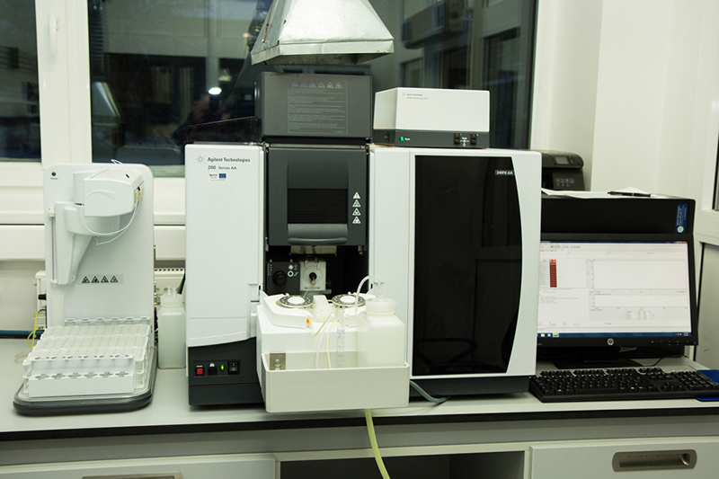
APPLICATIONS OF ATOMIC ABSORPTION
SPECTROSCOPY
BY – SIDRAH ASHRAF
ROLL NO: BT2406
MSC 1ST YEAR
DEPARTMENT OF BIOTECHNOLOGY
ISABELLA THOBURN COLLEGE

Slide 2

INTRODUCTION
Atomic Absorption Spectroscopy is an analytical technique used to determine the concentration of metal atoms or ions in a sample.
It was invented by Alan Walsh in 1950s.
It finds a purpose in quality control, toxicology and environmental testing . Firstly, all atoms or ions can absorb light at specific, unique wavelengths.
The amount of light absorbed at this wavelength is directly proportional to the concentration of the absorbing ions or atoms

Slide 3
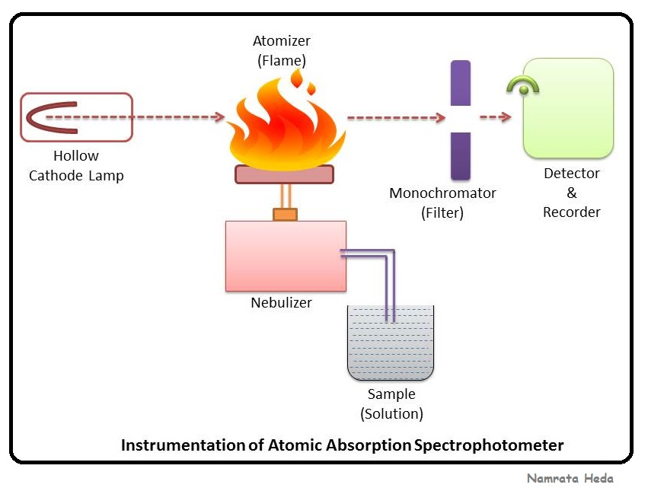
PRINCIPLE
It is a method is similar to that of spectrophotometer .The only exception is the replacement of the sample cell by a ﬂame.
•In this technique, a monochromatic light for a particular element is produced by a hollow cathode lamp utilizing that element as the cathode.
•The monochromatic light produced by the lamp is beamed through a long ﬂame into which is aspirated the solution to
be analysed.
•The heat energy dissociates the molecules and converts the components to atoms

Slide 4
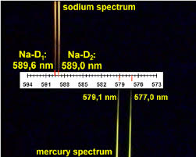
.•At ﬂame temperature, some atoms in the solution are activated, but most of the atoms are remain in the ground state.
•The ground state atoms of the same element as in the hollow cathode cup absorb their own resonance (reﬂected) lines.
•The amount of light absorbed varies directly with their
concentration in the ﬂame.
•The transmitted light that is not absorbed reaches the
monochromator.
•The monochromator passes only the wavelengths close to the resonance lines of the particular element to be analysed.
•Then the transmitted light strikes a detector and the decrease in transmitted light is measured.

Slide 5
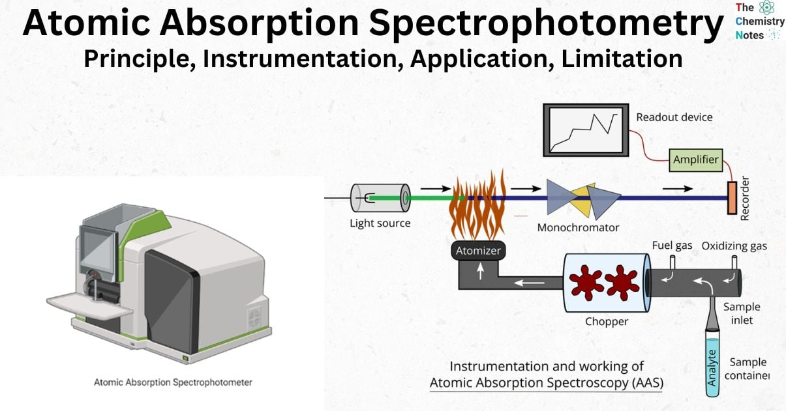
INSTRUMENTATION OF ATOMIC ABSORPTION SPECTROSCOPY
•The components of an AAS are :
Hollow cathode lamp
2. Beam chopper
3. The ﬂame or furnace
4. Nebulizer
5. Monochromator
6. Detector
7. Ampliﬁer.

Slide 6
APPLICATIONS OF ATOMIC ABSORPTION SPECTROSCOPY
Atomic Absorption Spectroscopy is one of the most useful analytical tools available to scientists, it uses light absorption and emission patterns to characterise the unique properties of matter.
Atomic absorption Spectroscopy is unique as it allows scientists to not only detect the presence of metallic elements within a sample, but also calculate concentrations.
It is particularly useful for detecting metals, making it instrumental to a broad spectrum of industries.
High sensitivity is another major benefit, due to which Atomic absorption Spectroscopy is capable of detecting parts per billion (ppb) concentrations.

Slide 7

AGRICULTURE
Atomic absorption spectroscopy is frequently utilized in agriculture and the study of environmental sciences.
Typically, they are used to identify and analyze the presence of potentially harmful elements in the environment.
One common use for these methods is the analysis of soil samples and the effect the quality of the soil on rate of food production in a certain area.
Can be used to determine the presence of the elements like P and N that enhance crop yield and also the quantities in which they appear.
These methods can also be used to detect trace amounts of harmful chemicals, such as rhodium, in water samples.

Slide 8

FORENSICS
Atomic absorption spectroscopy has been utilized in the study of
forensic sciences for many years. Using this technology, forensic
scientists:
Can perform in-depth analysis of blood samples,
Analysis of brain and muscle tissue, and gunshot powder
residue.
This technology has vastly improved the accuracy of
toxicology reports in cases of metal poisoning.
Common causes of metal poisoning, such as mercury and
lead, are easily detectable using this technology and can be identified
even in trace amounts.

Slide 9
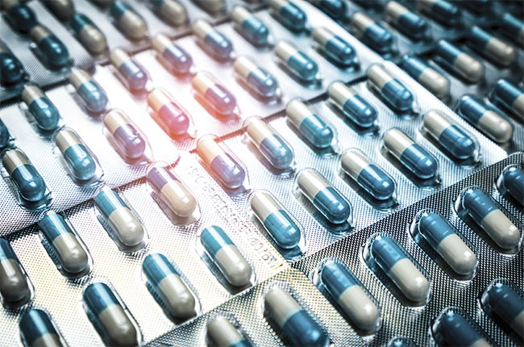
PHARMACEUTICALS
During the process of manufacturing of pharmaceuticals variety of metals and metalloids are used. Atomic absorption based techniques have also been used to:
Analyse the material used in the dental medicine for the determination of zirconium.
Quantification of tin in an antihelminthic powder which is used for the treatment of parasitic infections in animals.
Determination of lithium in antidepressants,
Palladium in synthetic drugs.
Determination of arsenic in the commercial samples of injectable drugs containing high concentrations of Antimony(Sb).

Slide 10

ENVIRONMENTAL ANALYSIS
Environmental pollution majorly includes pollution of water, air and soil. The quality of water is described in terms of the concentration and state of some or all of the organic and inorganic material present in water, together with certain physical characteristics of the water increase in automobile exhaust emission has added to the environmental pollution. Petroleum industry activities in addition to burning of fossil fuel have been reported as one of the primary sources of atmospheric metallic burden causing environmental pollution. Reports show that heavy metals such as nickel, cadmium, lead, chromium and manganese amongst others are responsible for various health related problems. Heavy metals cause systemic toxicity specifically neurotoxicity, fetotoxicity, teratogenic and nephrotoxicity effects
Number of spectroscopic methods has been used to monitor the levels of heavy metals in humans, animals and environment.

Slide 11
ADVANTAGES AND DISADVANTAGES 0F ATOMIC ABSORPTION SPECTROSCOPY
ADVANTAGES:
Accuracy: AAS is a highly accurate method that can produce results with a rate of 0.5–5%.
Sensitivity: AAS is a sensitive method that can detect elements down to parts per billion.
Cost: AAS is relatively inexpensive and has lower running costs than other methods.
Accessibility: AAS can reach places that were previously inaccessible because it relies on radiation and light absorption.
DISADVANTAGES :
Limited to metals: AAS is limited to metals because their atoms are easily readable and have clear absorption lines.
Destructive analysis: AAS is a destructive technique that involves converting the sample into an atomic gas.
Interference: Other chemicals in the sample or atmosphere can interfere with the results.
Equipment: While the equipment is often portable, it can be expensive.
Organic molecules: Large organic molecules can build up on the nebulizer surface, reducing its efficiency.

